Slide 1
Network Protection
09
Kai Bu
kaibu@zju.edu.cn
http://list.zju.edu.cn/kaibu/netsec2022

Slide 2
Network Protection
highly miscellaneous

Slide 3
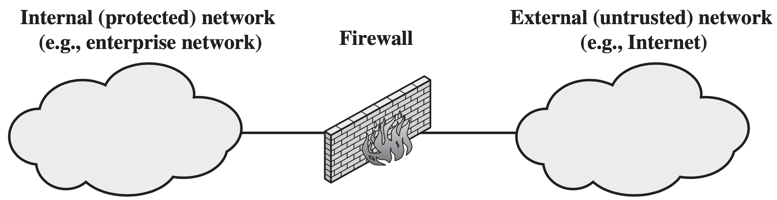
Firewall
Form a barrier through which the triffic going in each direction must pass
Use firewall security policy to dictate which traffic is authorized to pass in each direction

Slide 4
Design Goals
All traffic from inside to outside, and vice versa, must pass through the firewall.
Only authorized traffic, as defined by the local security policy, will be allowed to pass.
The firewall itself is immune to penetration.

Slide 5
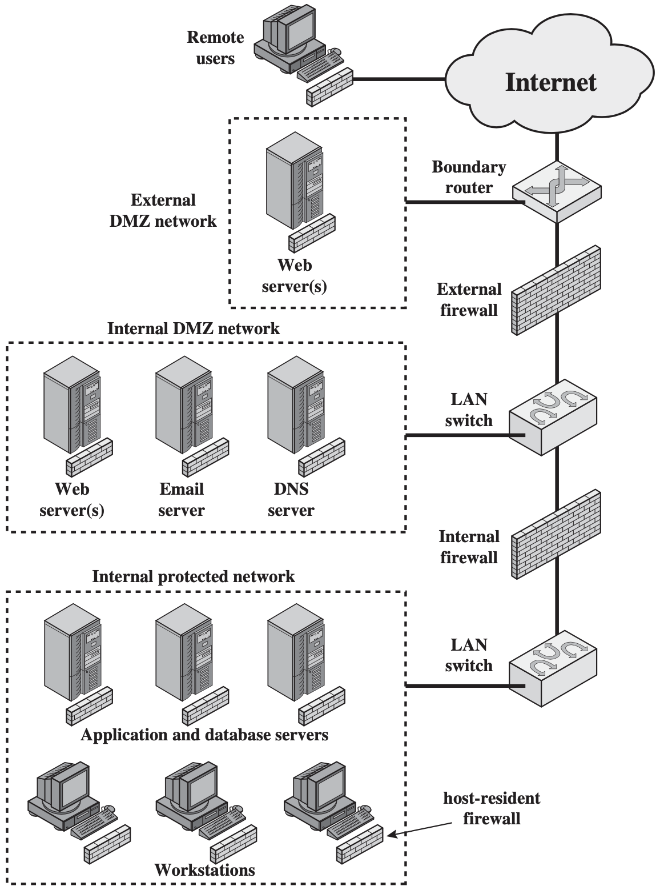
Distributed Firewalls
Stand-alone firewall devices plus host-based firewalls work together under a central administrative control

Slide 6
IDS
Detect unusual patterns of activity or patterns of activity that are known to correlate with intrusions
Provide early warning of an intrusion so that defensive action can be taken

Slide 7
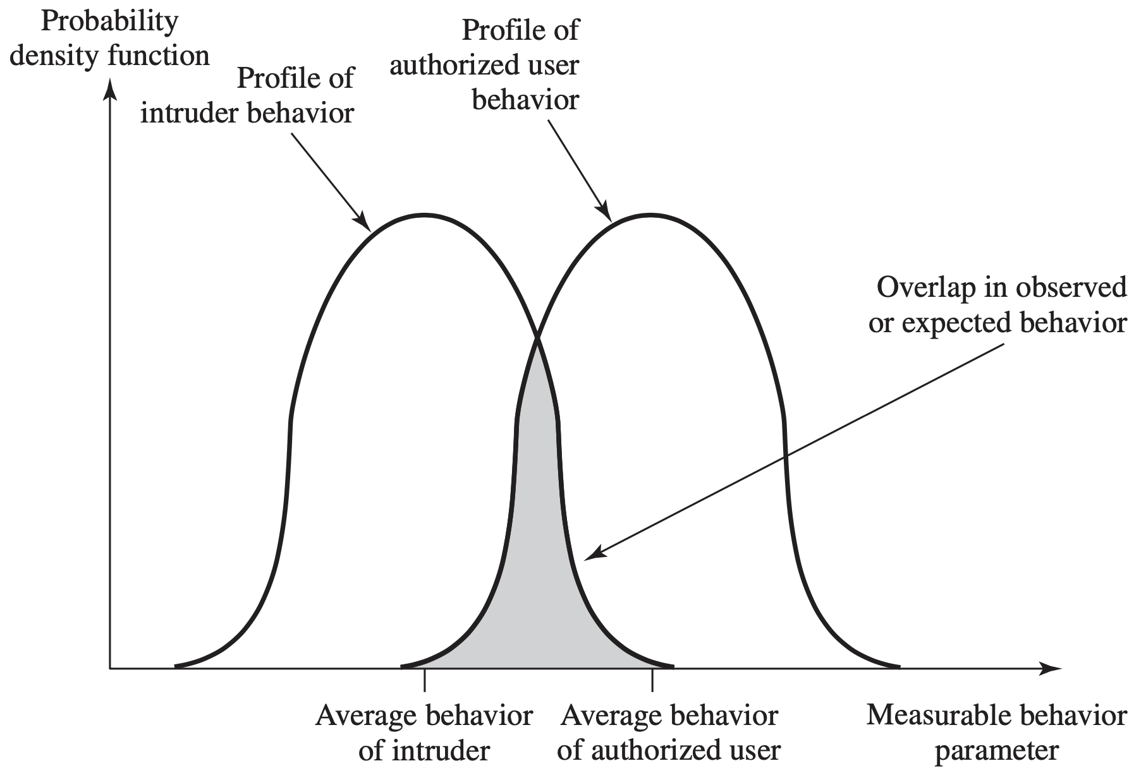
intruder behavior differs from that of a legitimate user in ways that can be quantified

Slide 8
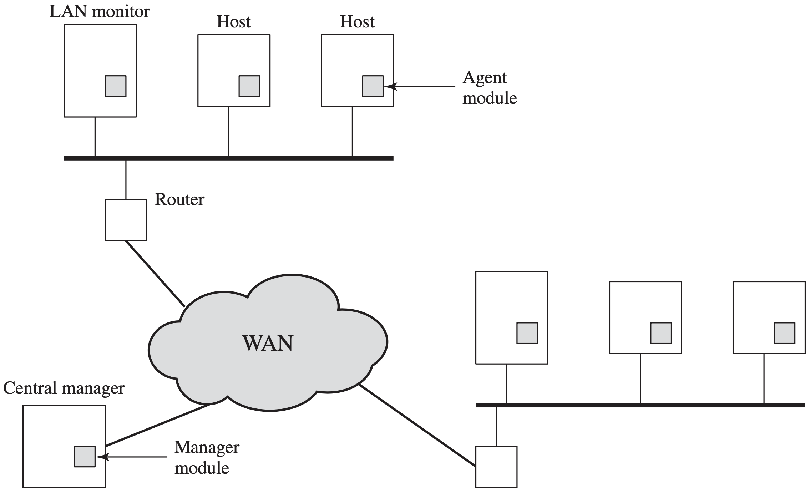
Distributed IDS

Slide 9
IPS
Intrusion Prevention System an extension of IDS to attempt to block or prevent detected malicious activity
Host-based, network-based, or distributed

Slide 10
IPS
Anomaly detection to identify behavior different from legitimate users
Signature/heuristic detection to identify malicious behavior

Slide 11
Honeypot
Decoy systems designed to lure a potential attacker away from critical systems
Collect information about the attacker’s activity
Encourage the attacker to stay on the system long enough for administrators to respond

Slide 12
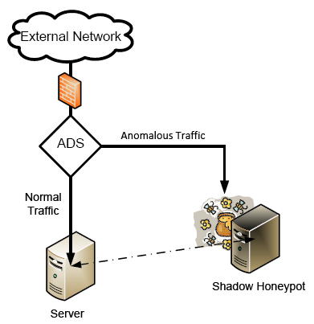
Honeypot
Decoy systems designed to lure a potential attacker away from critical systems
Collect information about the attacker’s activity
https://www.cse.wustl.edu/~jain/cse571-09/ftp/honey/

Slide 13
Honeywords
Associate false passwords (honeywords) with each user’s account
Attacker that steals (hashed) password file cannot distinguish from passwords from honeywords
Attempted login using a honeyword sets off an alarm
Notes:
https://people.csail.mit.edu/rivest/honeywords/

Slide 14
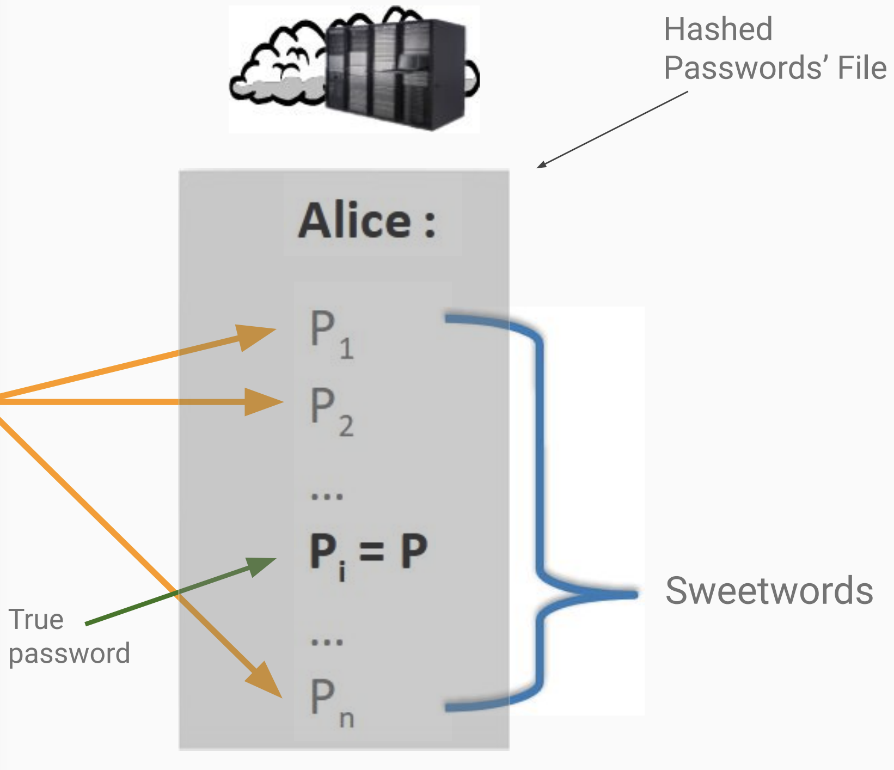
Honeywords
Honeywords
https://tinyurl.com/yc73cxc7

Slide 15
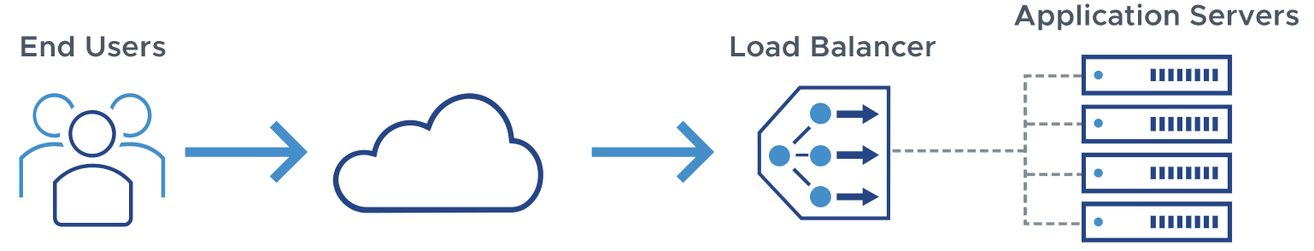
Load Balancing
Distribute network traffic across multiple servers
Mitigate single point of failure
https://avinetworks.com/what-is-load-balancing/

Slide 16
Load Balancing
Least Connection Method
Least Response Time Method
Round Robin Method
IP Hash

Slide 17
Load Balancing
Least Connection Method direct traffic to the server with the fewest active connections
Least Response Time Method
Round Robin Method
IP Hash

Slide 18
Load Balancing
Least Connection Method
Least Response Time Method direct traffic to the server with the fewest active connections and the lowest average response time
Round Robin Method
IP Hash

Slide 19
Load Balancing
Least Connection Method
Least Response Time Method
Round Robin Method direct traffic to one server after another following a fixed sequence
IP Hash

Slide 20
Load Balancing
Least Connection Method
Least Response Time Method
Round Robin Method
IP Hash direct traffic to the server indexed by the hash of the IP address

Slide 21
Traffic Scrubbing
Use a data cleansing service that analyzes traffic and filter maliciou traffic
Such service provider should be equipped with sufficient resources to sustain high volumetric floods

Slide 22
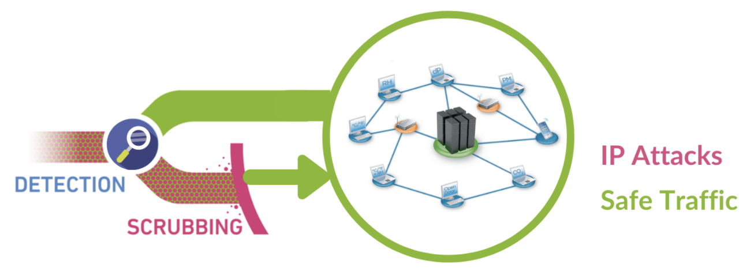
Traffic Scrubbing
Once an attack is detected, redirect traffic to scrubbing service
Analyze and filter malicious traffic
Deliver clean traffic to network/user
https://www.casbay.com/cyber-security/ddos-protection

Slide 23
User Authentication
The basis for most types of access control and for user accountability
The process of verifying an identity claimed by or for a system entity

Slide 24
User Authentication
Identification Step present an identifier to the security system
Verification Step present or generate authenticaton information that corroborates the binding between the entity and identifier
Notes:
In essence, identification is the means by which a user provides a claimed identity to the system; user authentication is the means of establishing the validity of the claim.

Slide 25
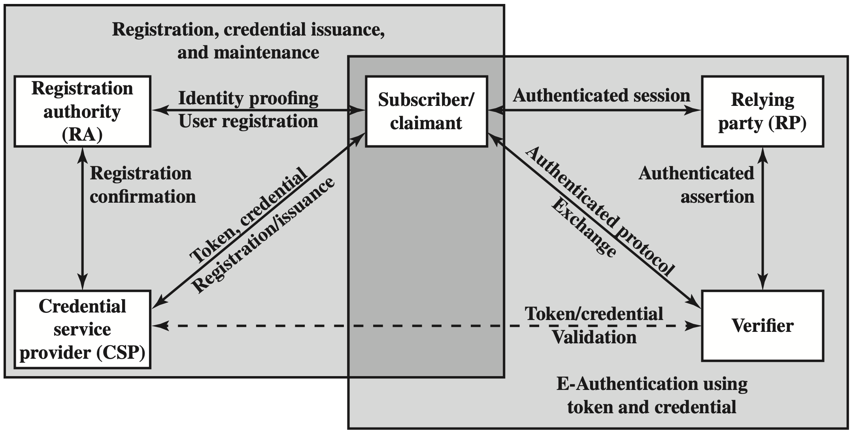
Model
NIST SP 800-63-2 E-Authentication
Notes:
The initial requirement for performing user authentication is that the user must be registered with the system. The following is a typical sequence for registration. An applicant applies to a registration authority (RA) to become a subscriber of a credential service provider (CSP). In this model, the RA is a trusted entity that establishes and vouches for the identity of an applicant to a CSP. The CSP then engages in an exchange with the subscriber. Depending on the details of the overall authentication system, the CSP issues some sort of electronic credential to the subscriber. The credential is a data structure that authoritatively binds an identity and additional attributes to a token possessed by a subscriber, and can be verified when presented
to the verifier in an authentication transaction. The token could be an encryption key or an encrypted password that identifies the subscriber. The token may be issued by the CSP, generated directly by the subscriber, or provided by a third party. The token and credential may be used in subsequent authentication events.
Once a user is registered as a subscriber, the actual authentication process can take place between the subscriber and one or more systems that perform authen- tication and, subsequently, authorization. The party to be authenticated is called a claimant and the party verifying that identity is called a verifier. When a claimant successfully demonstrates possession and control of a token to a verifier through an authentication protocol, the verifier can verify that the claimant is the subscriber named in the corresponding credential. The verifier passes on an assertion about the identity of the subscriber to the relying party (RP). That assertion includes identity information about a subscriber, such as the subscriber name, an identifier assigned at registration, or other subscriber attributes that were verified in the registration process. The RP can use the authenticated information provided by the verifier to make access control or authorization decisions.
An implemented system for authentication will differ from or be more com- plex than this simplified model, but the model illustrates the key roles and functions needed for a secure authentication system.

Slide 26
Means of Authentication
Information the user knows
Information the user possesses
Information the user is
Information the user does

Slide 27
Means of Authentication
Information the user knows passwords, personal identification number (PIN), answers to a prearranged questions
Information the user possesses
Information the user is
Information the user does

Slide 28
Means of Authentication
Information the user knows
Information the user possesses electronic keycards, smart cards, physical keys
Information the user is
Information the user does

Slide 29
Means of Authentication
Information the user knows
Information the user possesses
Information the user is static biometrics: fingerprint, retina, face
Information the user does

Slide 30
Means of Authentication
Information the user knows
Information the user possesses
Information the user is
Information the user does dynamic biometrics: voice pattern, handwriting characteristics, typing rhythm

Slide 31
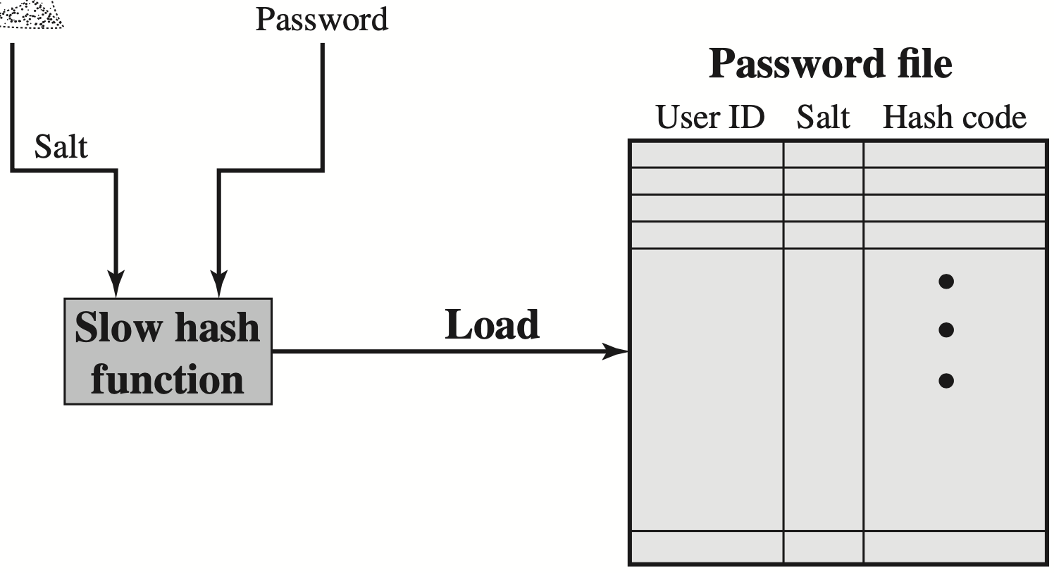
Password
Register a new password
Notes:
A cryptographic salt is made up of random bits added to each password instance before its hashing. Salts create unique passwords even in the instance of two users choosing the same passwords. Salts help us mitigate hash table attacks by forcing attackers to re-compute them using the salts for each user.

Slide 32
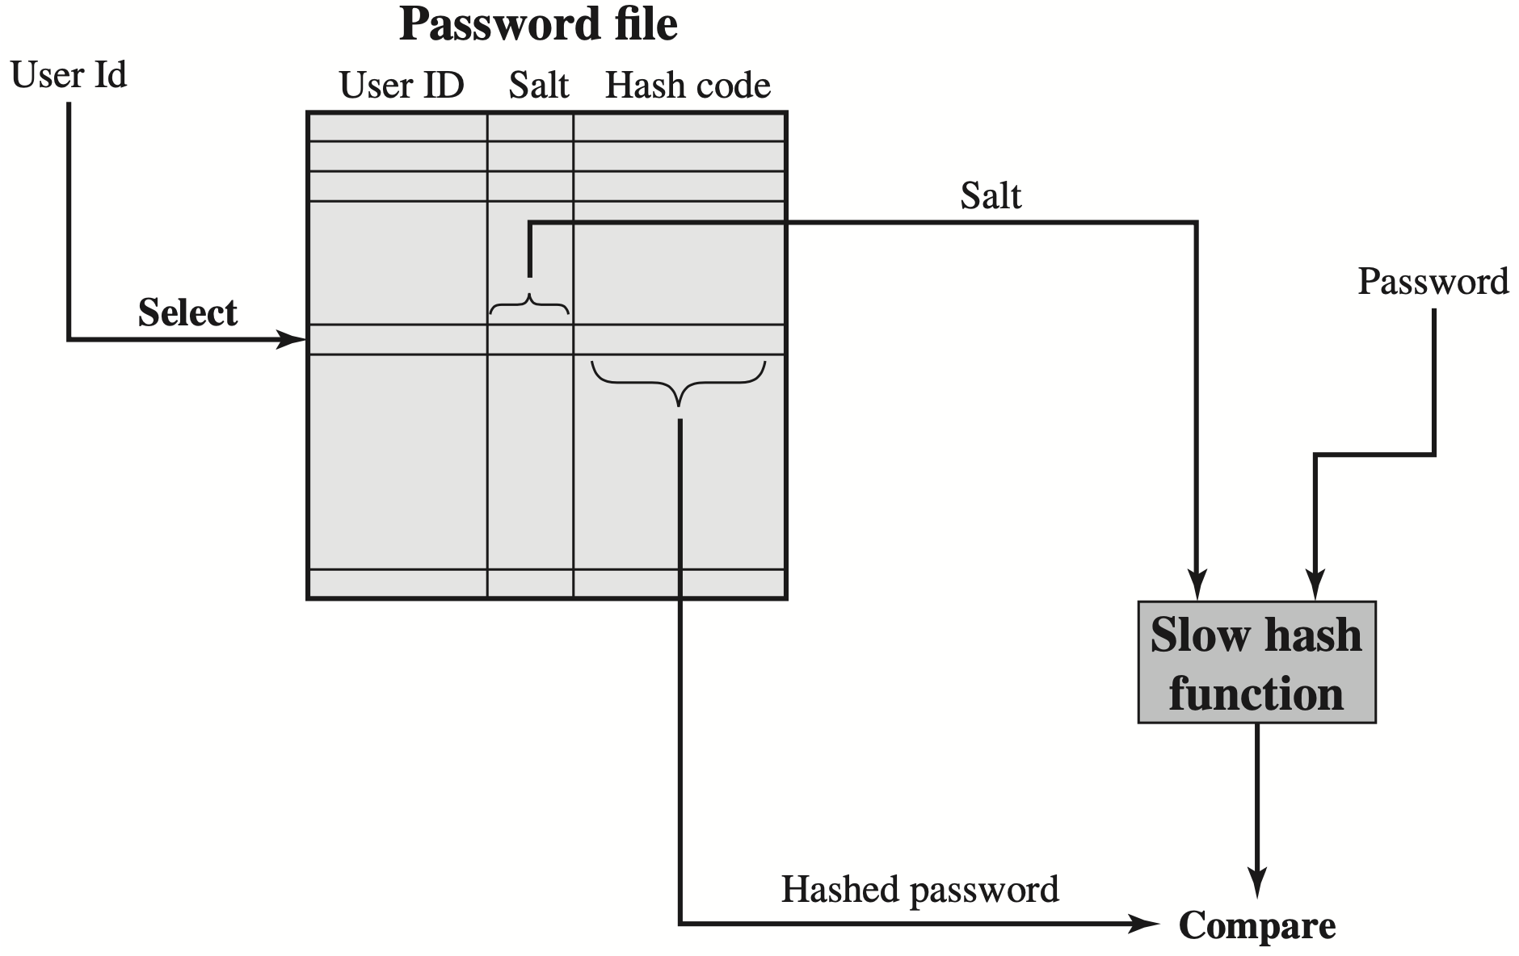
Password
Verify a password

Slide 33
Salt Purpose
Prevent duplicate passwords from being visible in the password file
Greatly increase the difficulty of offline dictionary attacks
Greatly increase the difficulty of finding out whether a person has used the same password on two or more systems

Slide 34
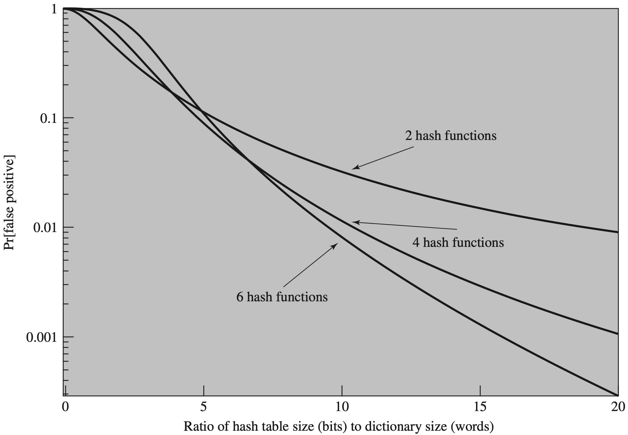
Bloom Filter

Slide 35
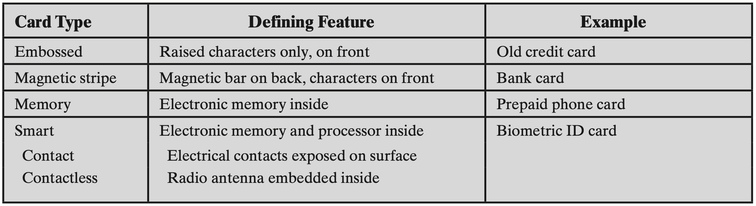
Token
Objects that a user possesses for the purpose of user authentication

Slide 36
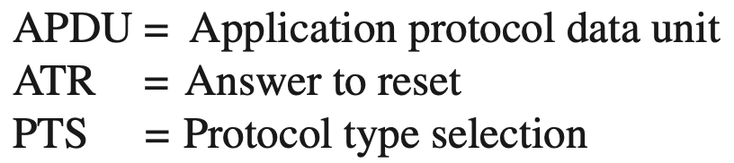
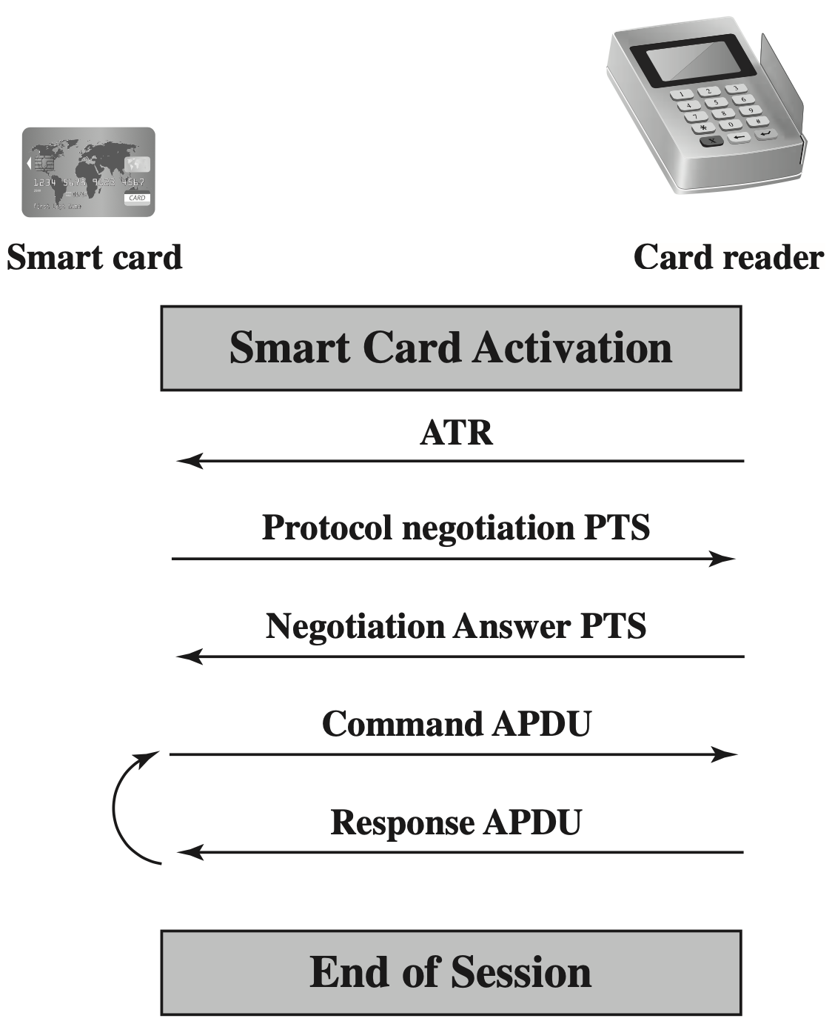
Token

Slide 37
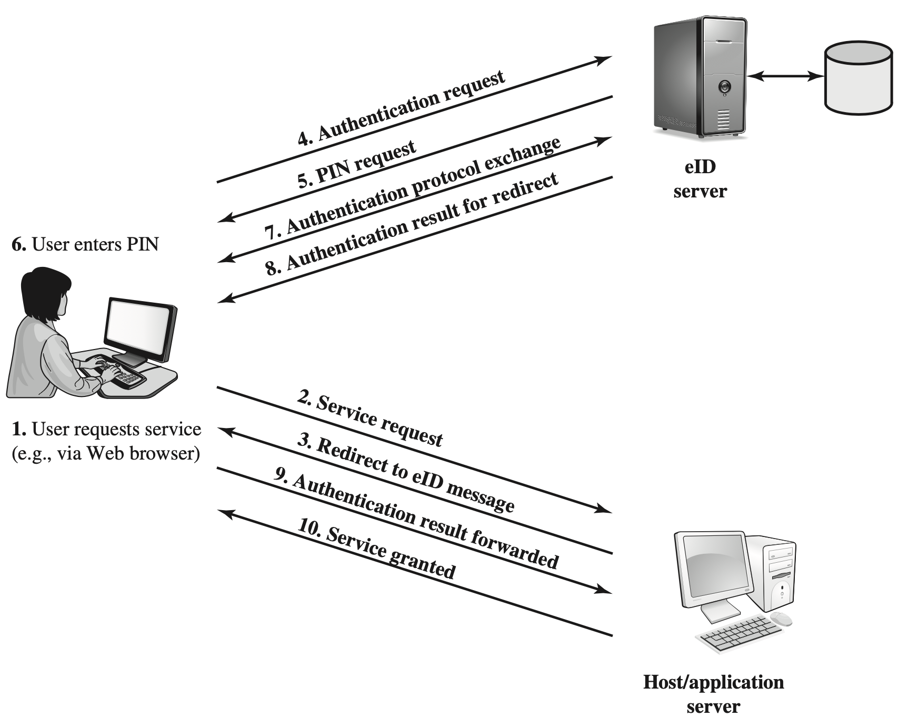
Token

Slide 38
Biometric
Authenticate a user based on the user’s unique physical characteristics: facial characteristics fingerprints hand geometry retinal pattern iris signature voice

Slide 39
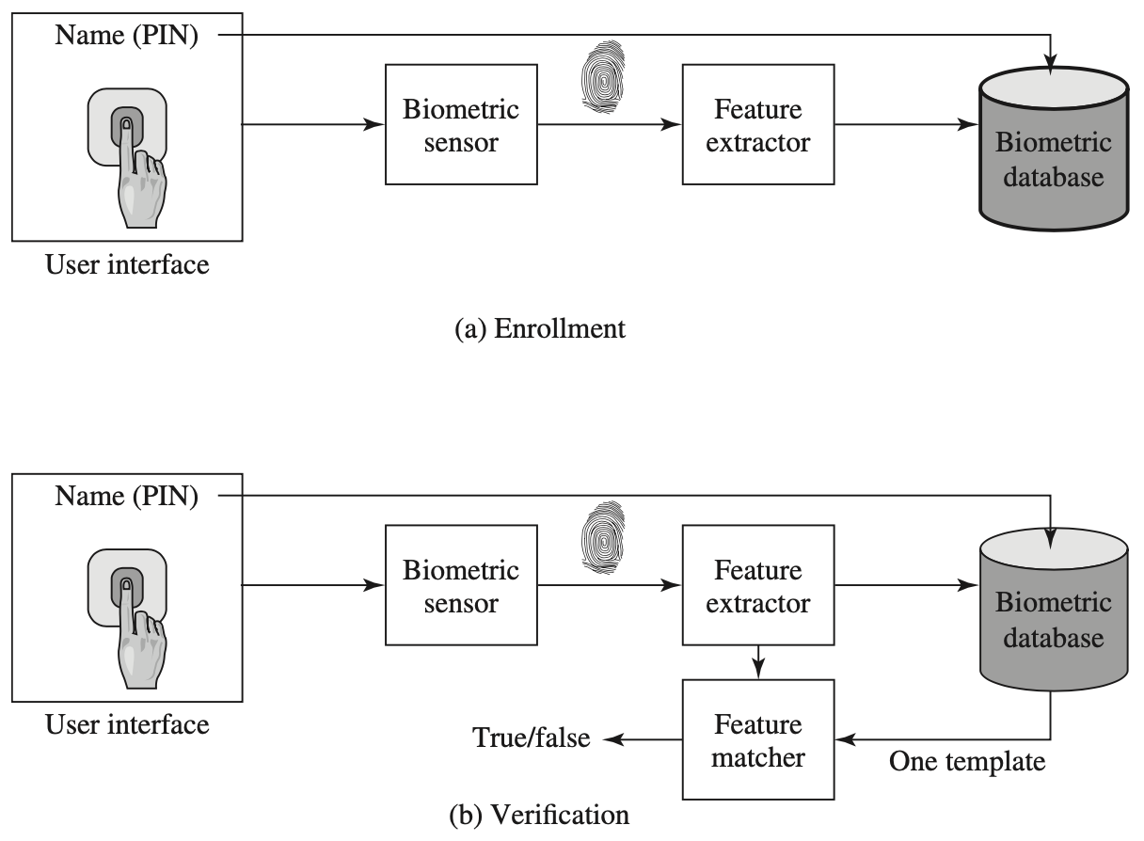
Biometric

Slide 40
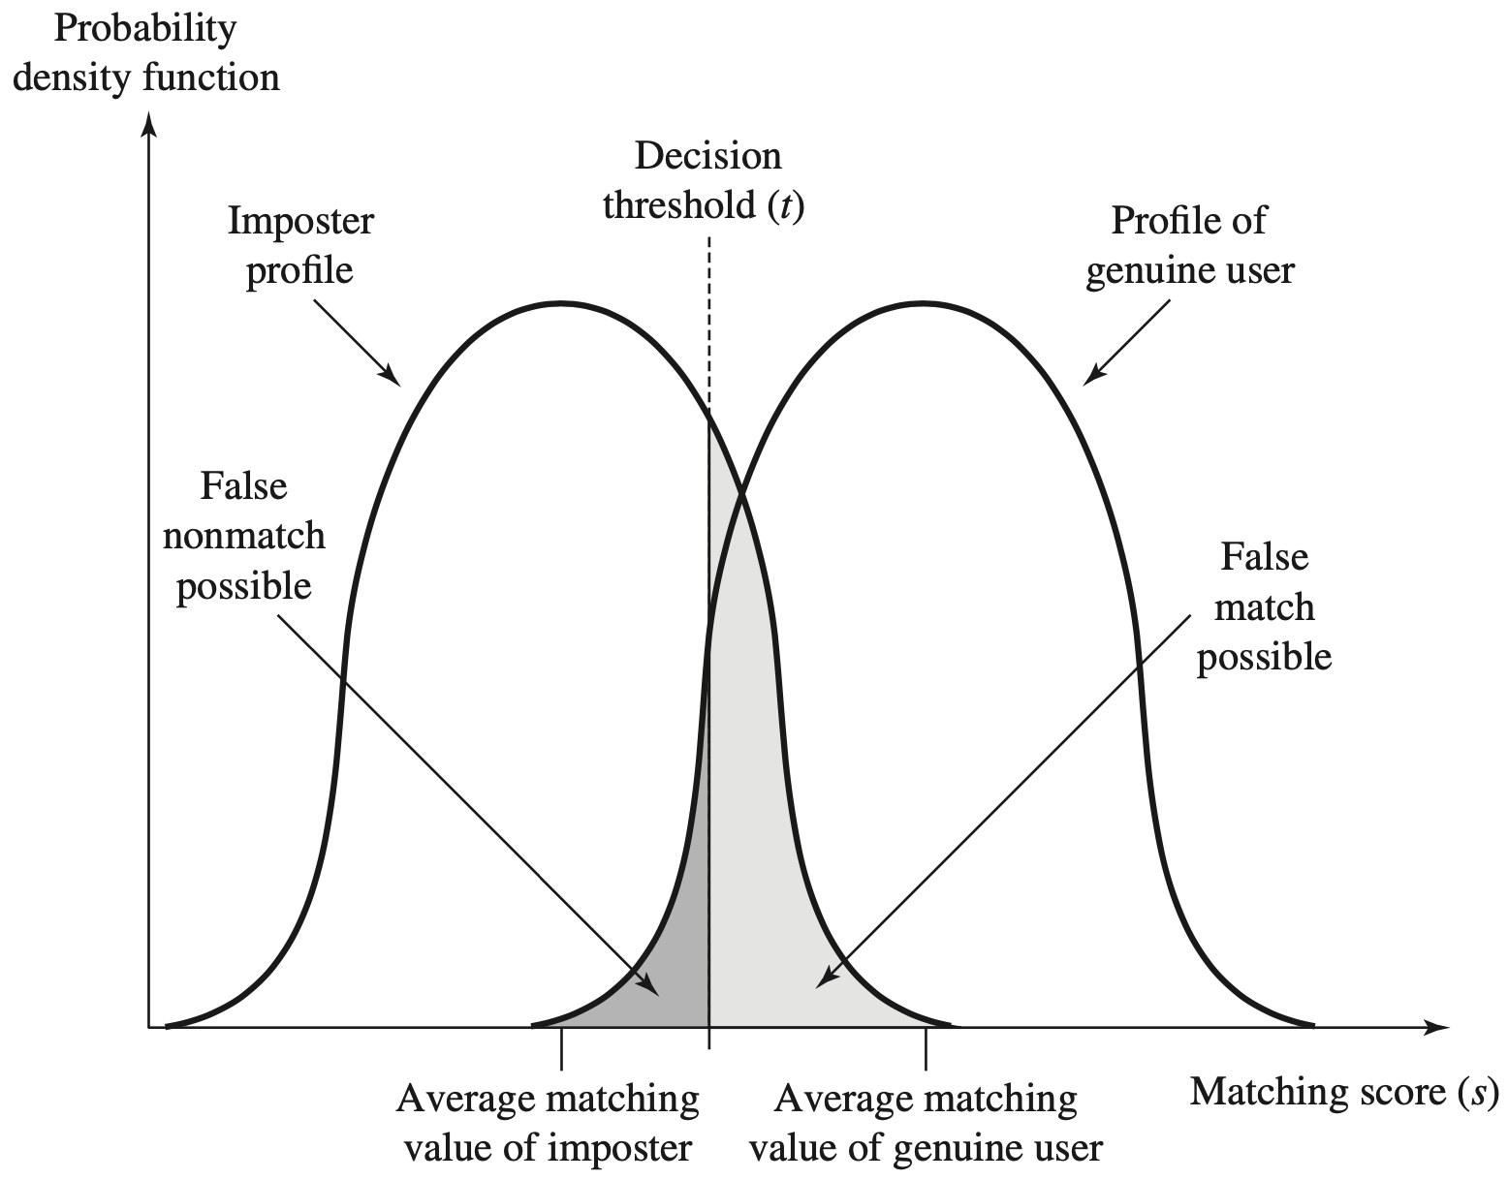
Accuracy

Slide 41
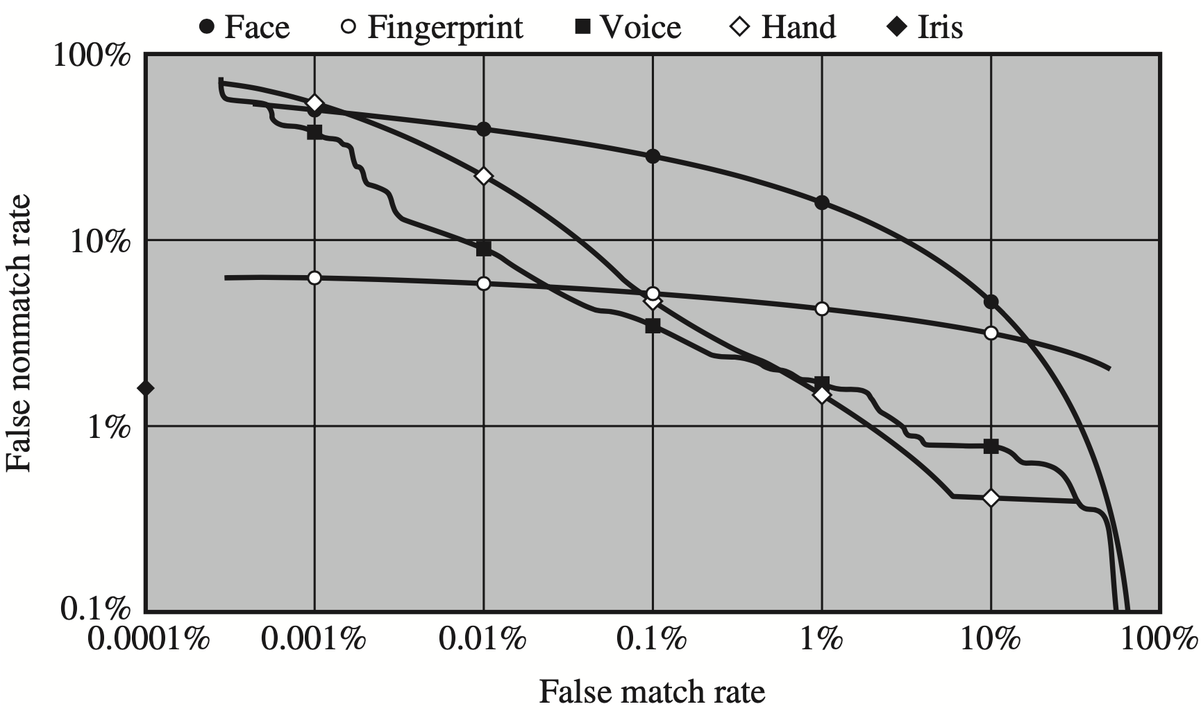
Accuracy

Slide 42
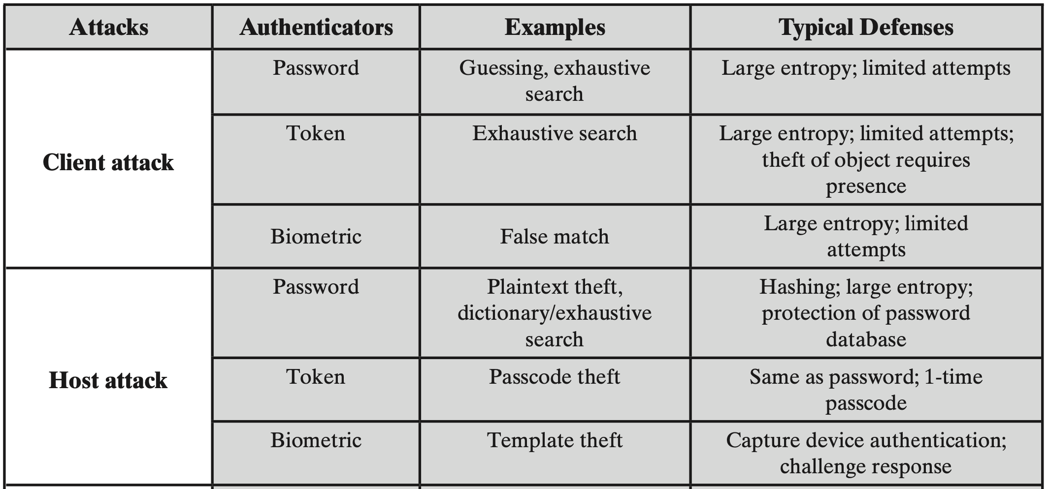
Attack and Defense

Slide 43
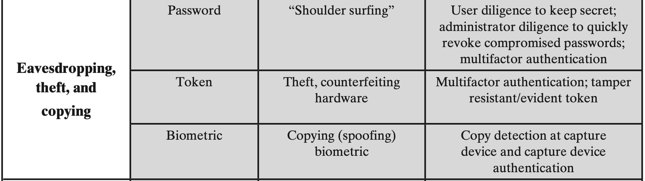
Attack and Defense

Slide 44
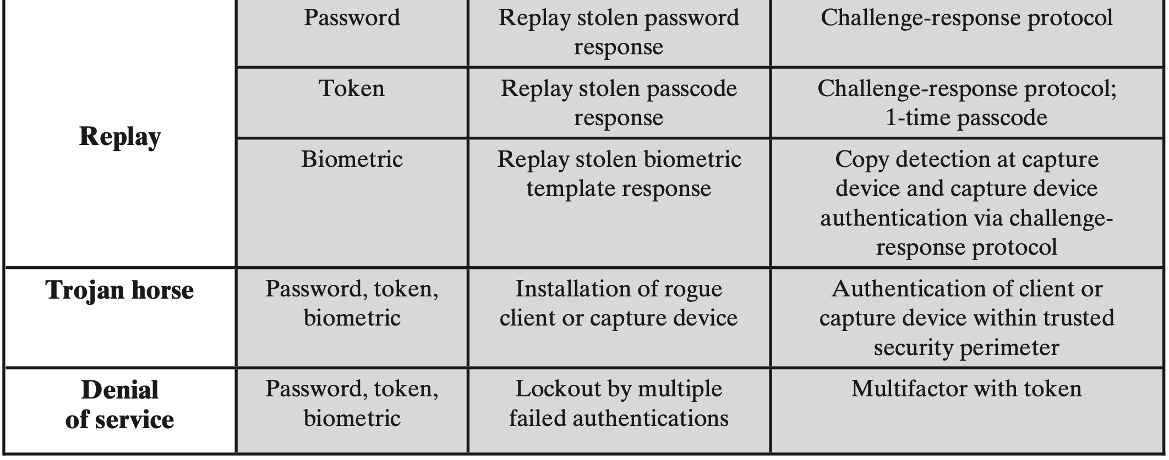
Attack and Defense

Slide 45
Access Control
Implement a security policy that specifies who or what (e.g., a process) may have access to each specific system resource and the type of access that is permitted in each instance

Slide 46
Elements
Subject
Object
Access Right
Authorize a subject with some access right(s) for some object(s)

Slide 47
Subject
Entity capable of of accessing objects
Owner creator of a resource, system administrator, project leader, etc.
Group a named group of uses with shared access rights; a user may belong to multiple groups.
World users other than owner and group

Slide 48
Object
Resource to which access is controlled
Entity used to contain and/or receive information

Slide 49
Access Right
Describe the way in which a subject may access an object
Read, write, execute, delete, create, search…

Slide 50
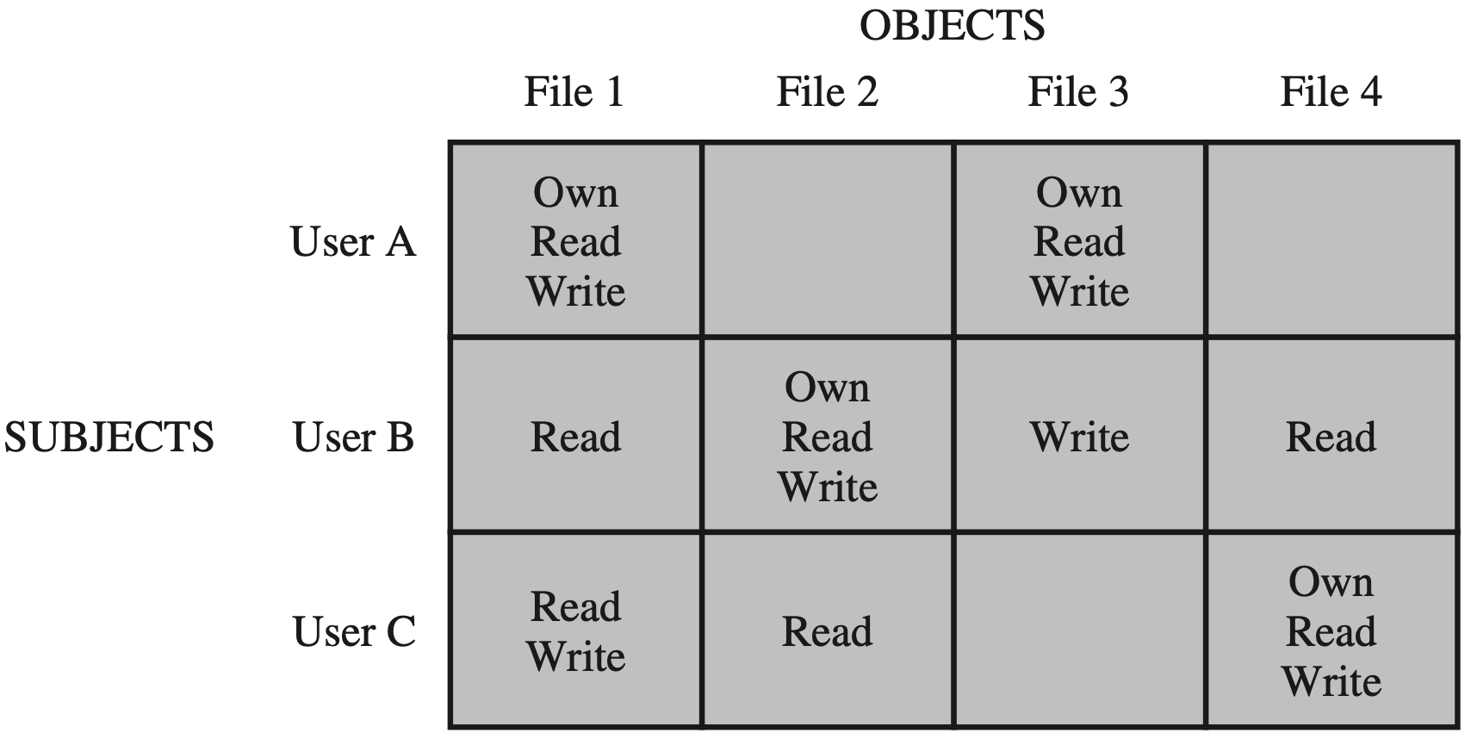
DAC
Discretionary Access Control
Access Matrix

Slide 51
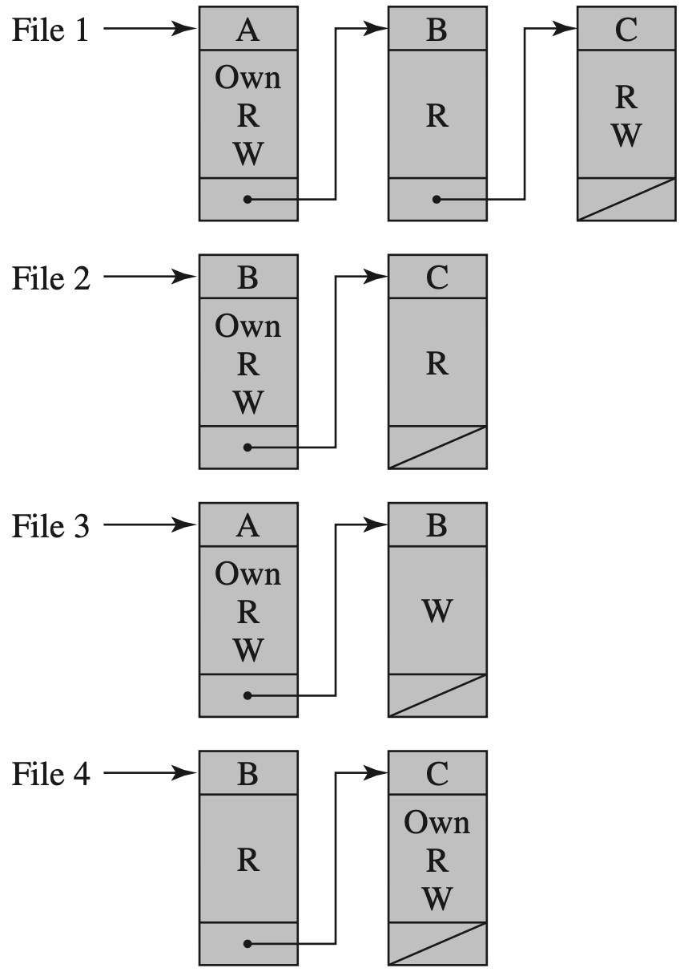
DAC
Discretionary Access Control
ACL: Access Control List

Slide 52
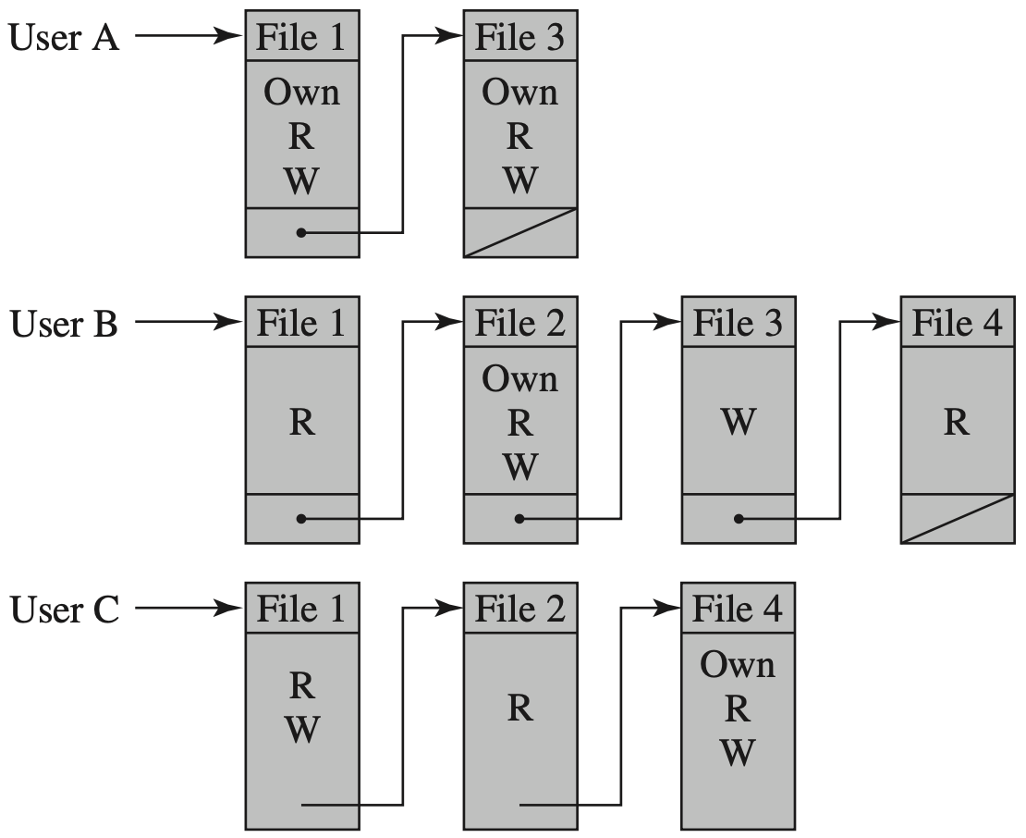
DAC
Discretionary Access Control
Capability List

Slide 53
RBAC
Role-Based Access Control
Assign users with different roles according to their responsibilities
Check the roles that users assume in a system rather than the user’s identity

Slide 54
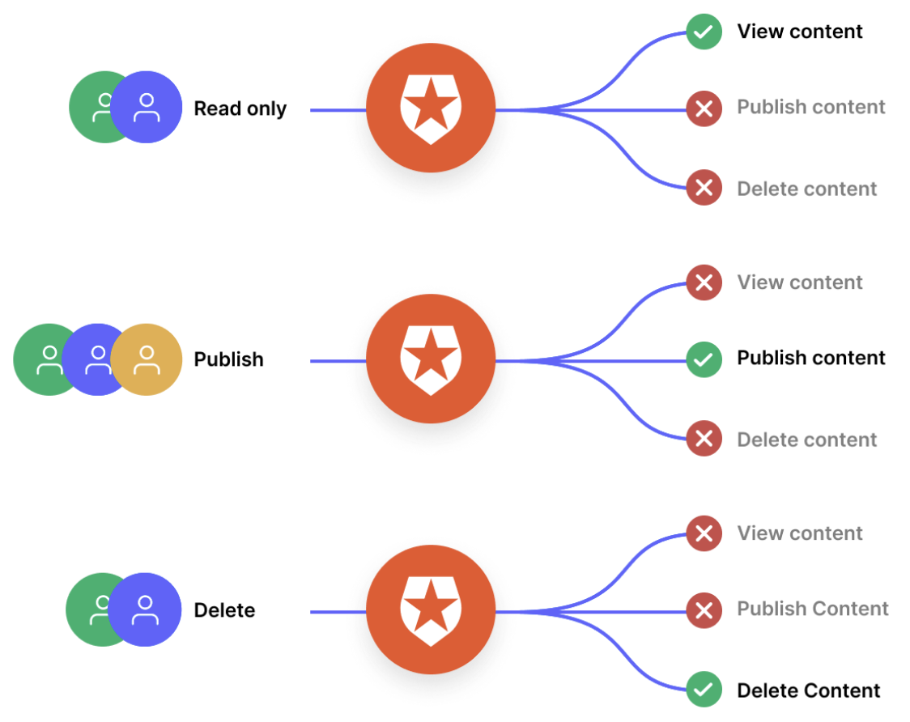
RBAC
https://auth0.com/access-management

Slide 55
ABAC
Attribute-Based Access Control
Define authorizations that express conditions on properties of both the resource and the subject

Slide 56
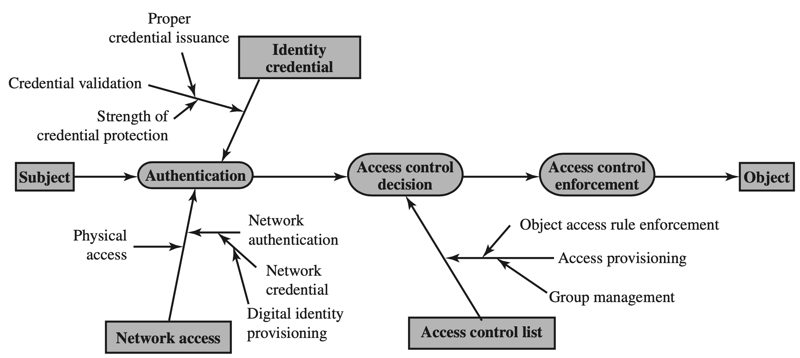
ACL

Slide 57
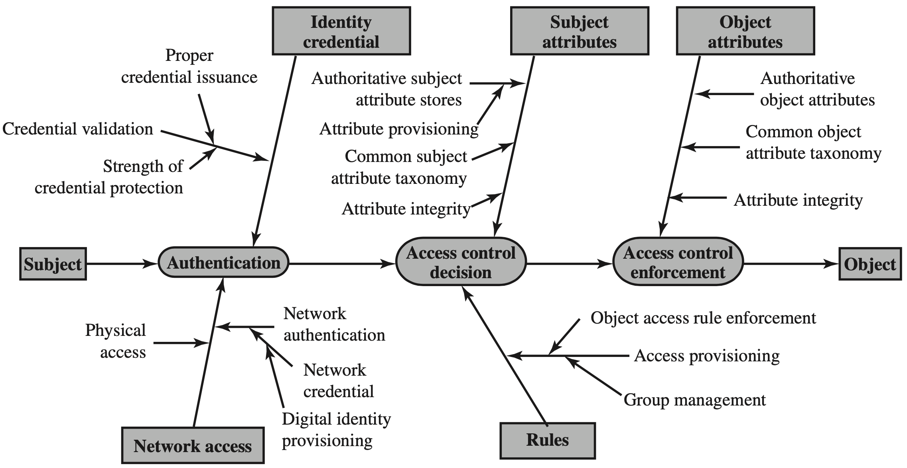
ABAC

Slide 58
Incident Response
Cyclical activity featuring ongoing learning and advancements to discover how to best protect the organization.
Four main stages: preparation, detection/analysis, containment/eradication, and recovery

Slide 59
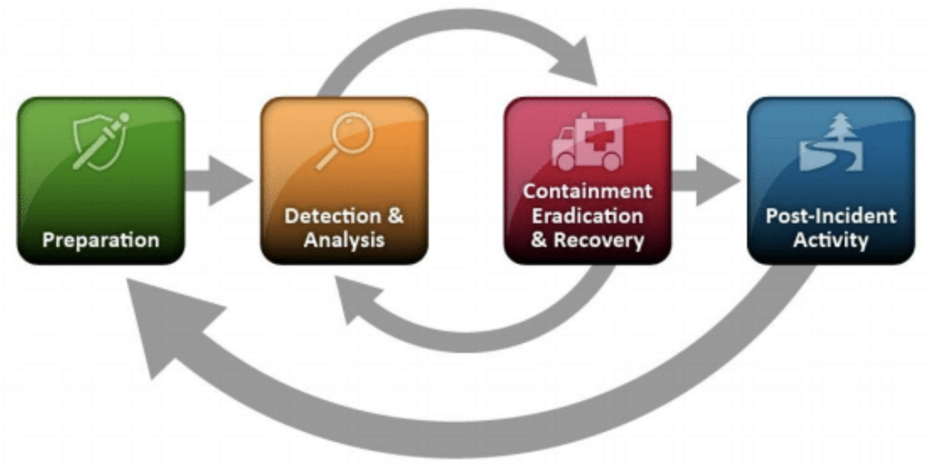
Incident Response
Cyclical activity featuring ongoing learning and advancements to discover how to best protect the organization.
Four main stages:
https://www.cynet.com/incident-response/nist-incident-response/

Slide 60
Incident Response
Assemble a team of experts
Detect and ascertain the source
Contrain and recover
Assess damage and severity
Begin the notification process
Take actions for prevention
…
https://www.exabeam.com/incident-response/steps/

Slide 61
?

Slide 62
Readings
Computer Security: Principles and Practice
by William Stallings
Chapter 3: User Authentication
Chapter 4: Access Control

Slide 63

Thank You
be empathetic
every face along the boulevard
is a dreamer just like you

Slide 64
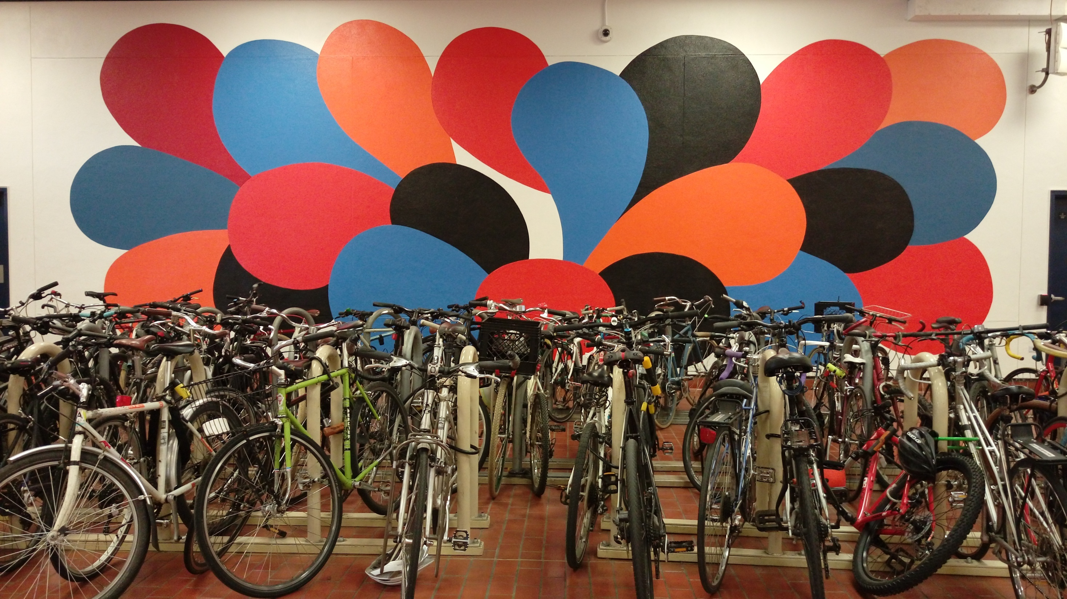
Thank You
run your own race
Notes:
Run your own race.

